Slide 1
Application in Finance II Topological Data Analysis
Machine-Learning-based Market Crash Early Indicator and How TDA Can Boost the Performance at High Cut-offs

Slide 2
Content
The Problem 1.0
The Results 1.0
The Data
The Model
The Problem 2.0
Recap on TDA Intro
The Results 2.0
The Results in details

Slide 3
The Problem 1.0 - Motivation
Market moves in cycles: spikes followed by crashes, vice versa
There are handful of “crash” indicators summarised by practitioners from experience:
Yield Spreads: 2-10 year, CDS
Commodity and Rates: Gold and Treasury Bonds as flight-to-safety
Volatility spikes
Sectorial Rotations
In the AI/ML era, leveraging the expanded amount of data and computing power, Financial Machine Learning is gathering momentum to augment our insights in understanding market crashes

Slide 4
The Problem 1.0
Based on the public data, can we develop an ML-powered market crash indicator to quantify the risk of market crashes in a given forecasting window (e.g. 2w), in terms of probability?
Something has been done:
“Predicting stock market crashes” – Roman Moser, Jan 2019
“Forecasting stock market crisis events using deep and statistical machine learning techniques” - Sotirios P. Chatzis et al. June 2018

Slide 5
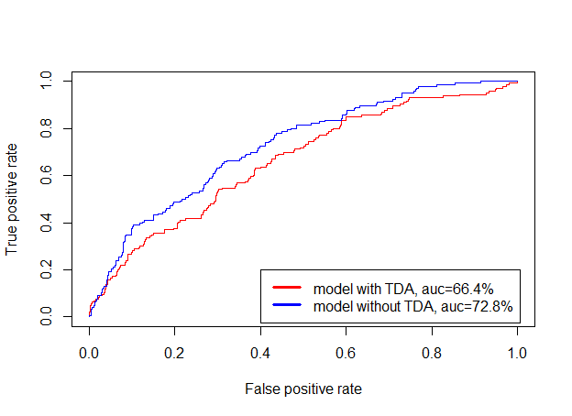
The Results 1.0
AUC Score (on Hang Seng Index down > 5% in 2w) = 72.8%

Slide 6
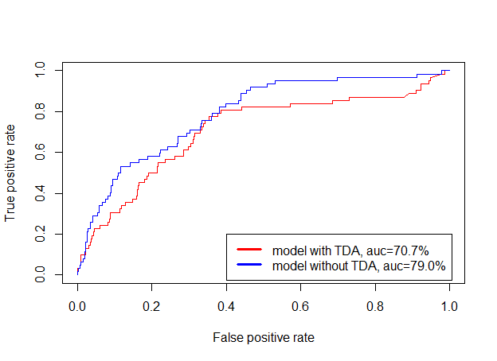
The Results 1.0
AUC Score (on S&P 500 down > 5% in 2w) = 79.0%

Slide 7
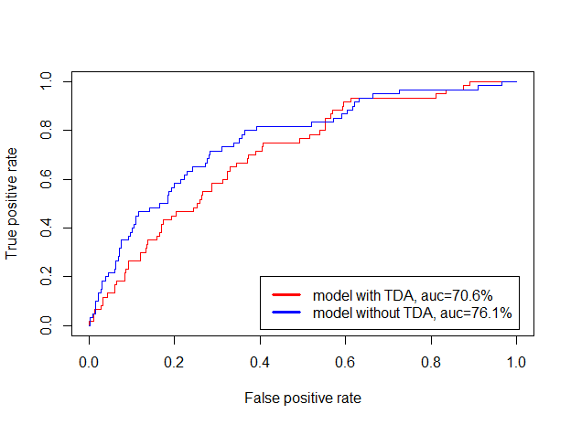
The Results 1.0
AUC Score (on FSTE 100 down > 5% in 2w) = 76.1%

Slide 8
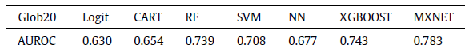
The Results 1.0
Comparable to the results in the “Chatzis et al” paper (2nd reference paper above):
However, “Financial Machine Learning” and “Market Crashes” are also biased to false positives at the high cut-offs

Slide 9
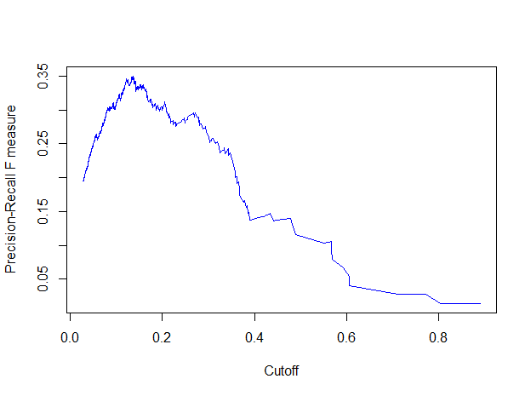
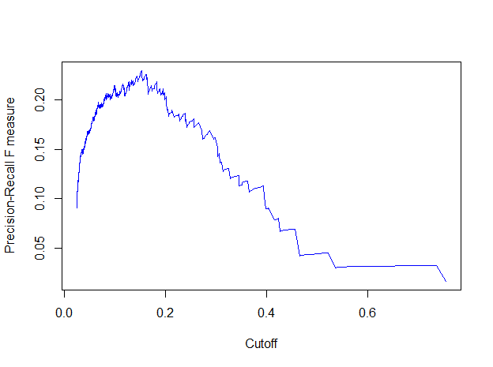
The Results 1.0
F1 vs. Cutoff (on HSI down > 5% in 2w)
F1 vs. Cutoff (on S&P 500 down > 5% in 2w)

Slide 10
The Data
35 years of weekly price (covering major crashes since 1983)
Asset types covering: Equity, FI, FX, Commodities (& Fama French Factors)
Parsimonious approach to Feature Engineering (→ c. 10 features/dimensions):
Return/Change/Momentum features
Spread features
Volatility features
Meta parameters:
forecast window = 2w
TH = 5% (i.e. Y=1 for chosen index drop > 5%, Y=0 otherwise)
training batch window = 26w
rolling step size = 1w
→ c. 3000 data points in total

Slide 11
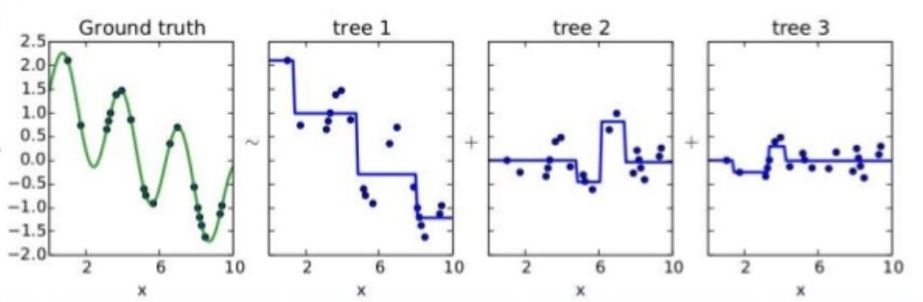
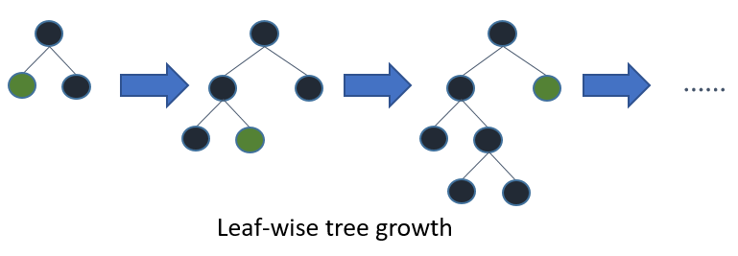
The Model
Best Results vs. SVM vs. CNN vs. Regression
Tree-based
Transparent and whitebox as regression vs. deep neural networks
Free from normalisation/standardisation of the features vs. regression
Kagglers’ love (used by 17 out of 29 winners)

Slide 12

The Model
“Online” Learning:
Roll 2w of data
Return/Change Features
Return/Change Features
XGBoost Model
(Training)
XGBoost Model
(Testing)
Y:
Ground Truth
Spread Features
$Y$:
Prediction
Spread Features
Volatility Features
Volatility Features

Slide 13
The Problem 2.0
How do we improve the model performance at high cutoffs?
Beyond all the conventional features/market factors, are we missing anything actually matters?

Slide 14
Recap on Topological Data Analysis
Topologists perhaps are best defined as the people with “disability” to tell doughnuts from mugs or vice versa:

Slide 15
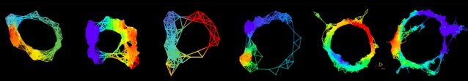
Recap on Topological Data Analysis
“Data has shapes, shape matters.” - Ayasdi

Slide 16
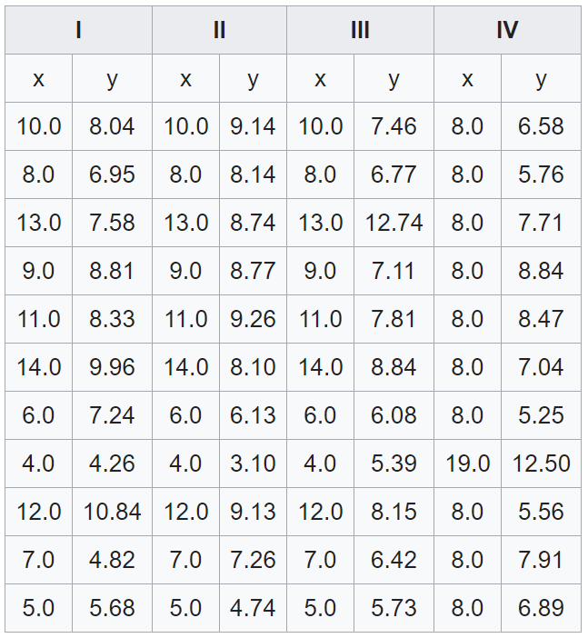
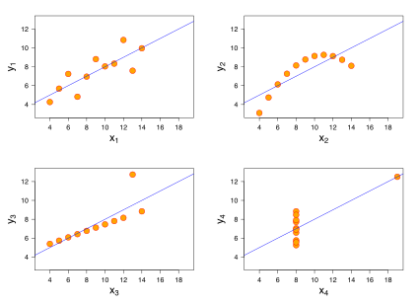
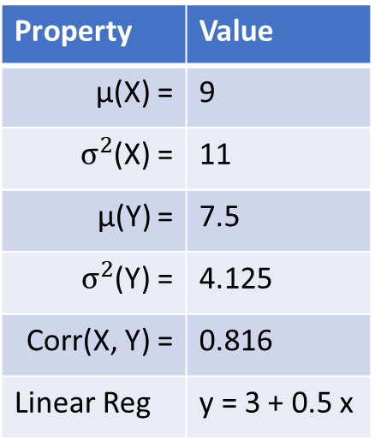
Recap on Topological Data Analysis
Property | Value
µ(X) = | 9
$σ^{2}$(X) = | 11
µ(Y) = | 7.5
$σ^{2}$(Y) = | 4.125
Corr(X, Y) = | 0.816
Linear Reg | y = 3 + 0.5 x

Slide 17
Recap on Topological Data Analysis

Slide 18

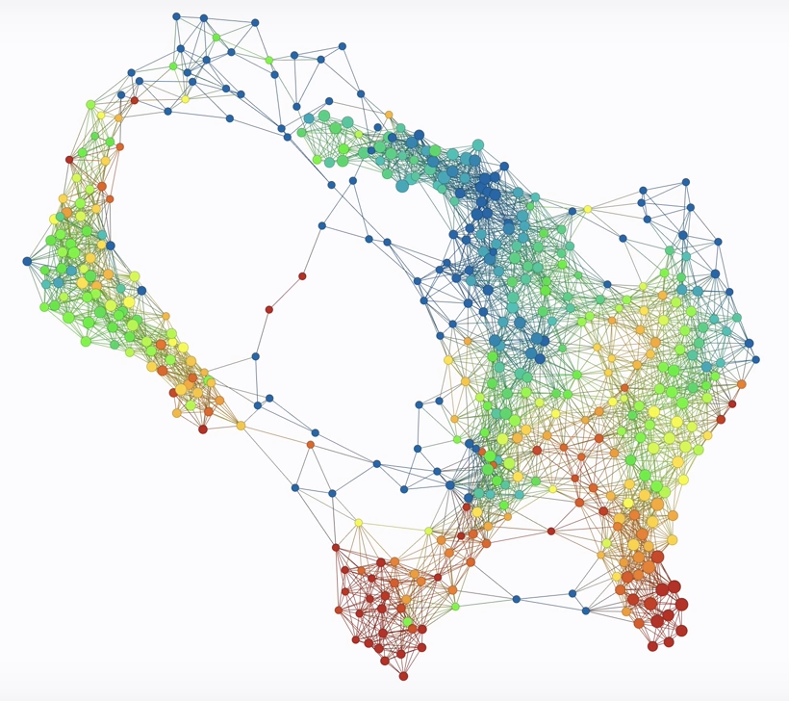
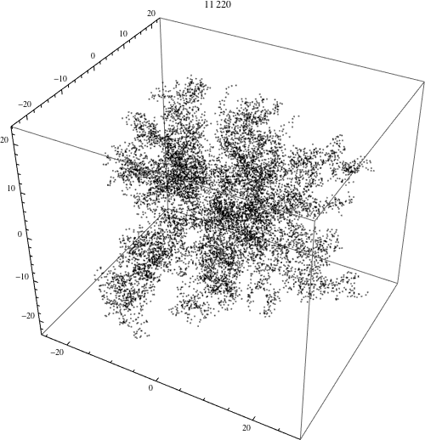
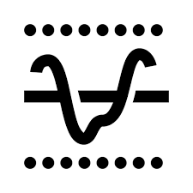


How does TDA work?
Data → Point Cloud → Complex
1
2
3
Vectorisation/
Feature Engineering
→ Space Embedding
Metric → Structure → Complex

Slide 19
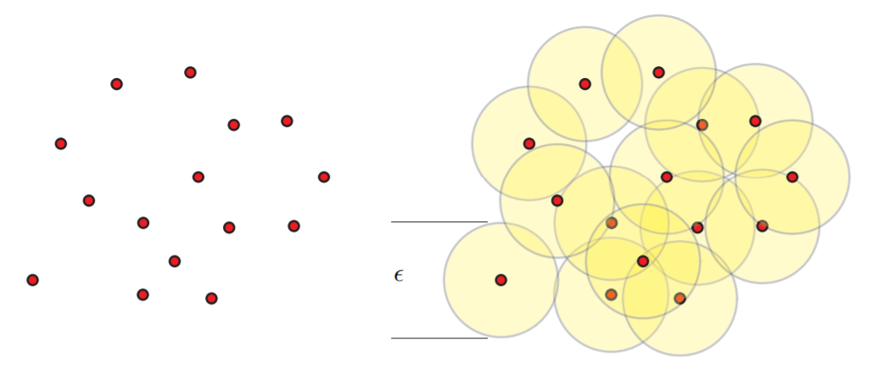
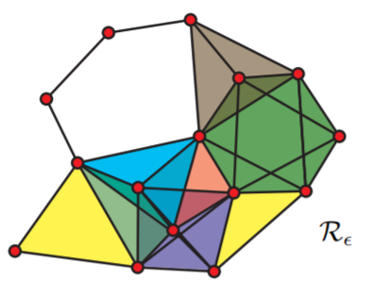
How does TDA work?
Point Cloud → ε → Complex
Question: which “ε” ?

Slide 20
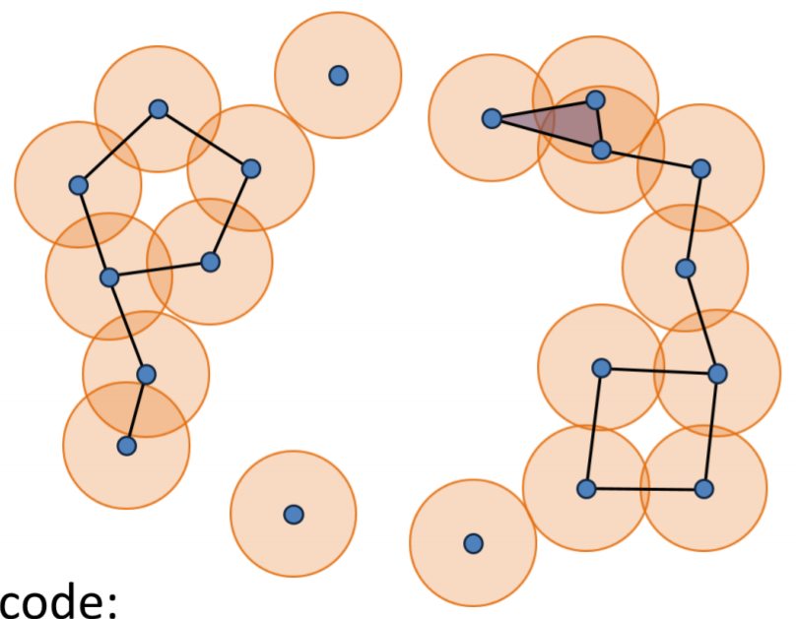
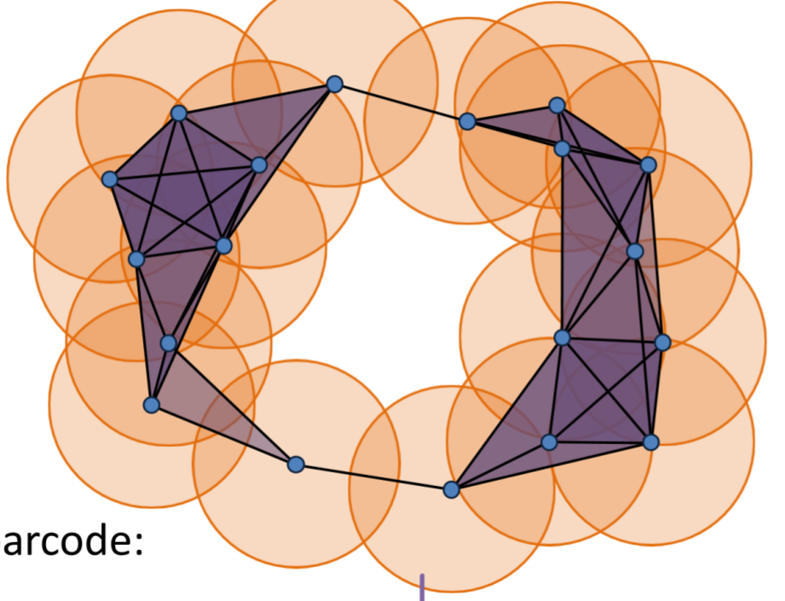
How does TDA work?
Which “ε” ?

Slide 21
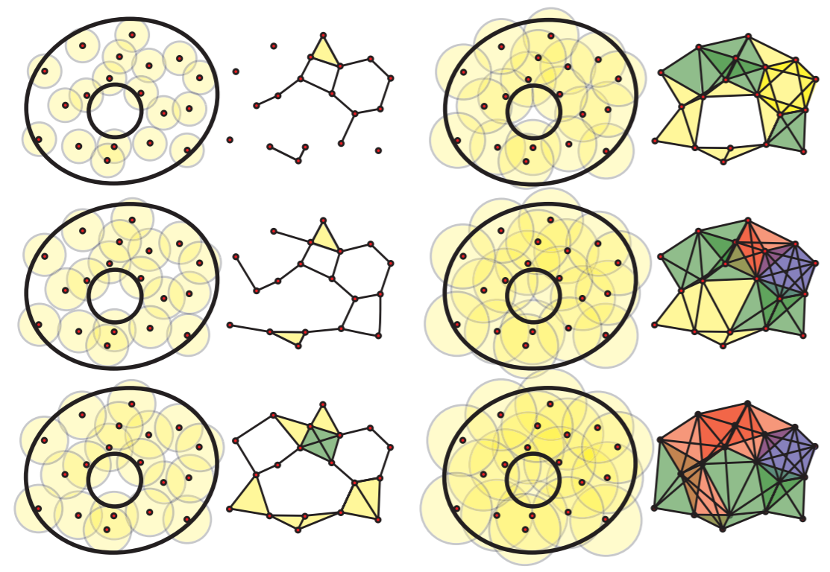
How does TDA work?
Barcode

Slide 22
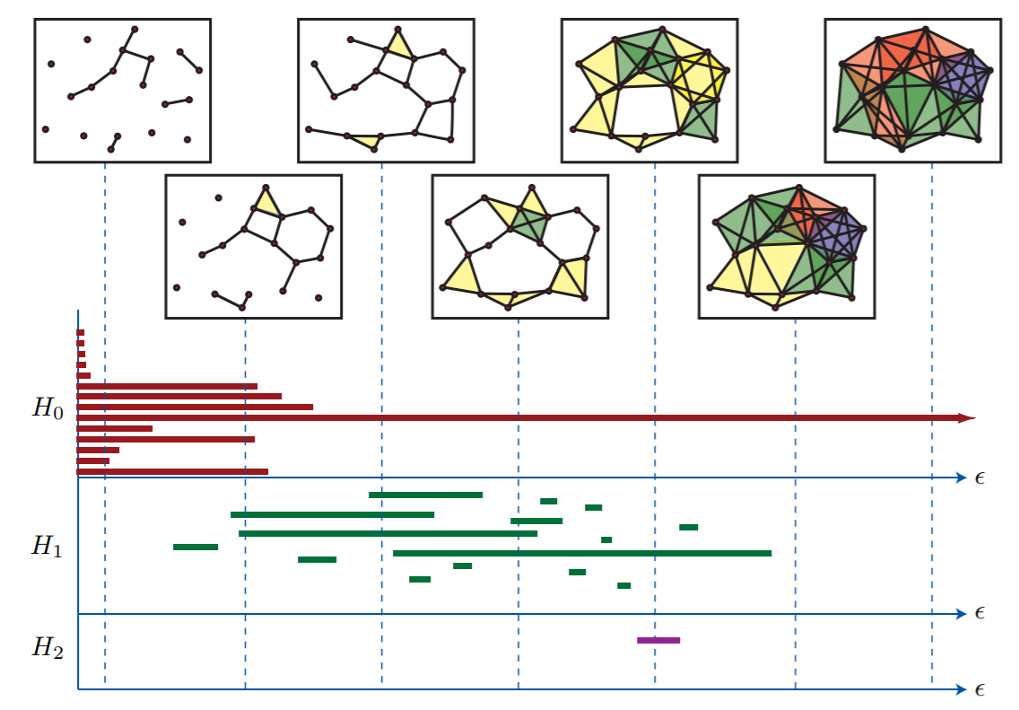
How does TDA work?
Barcode

Slide 23
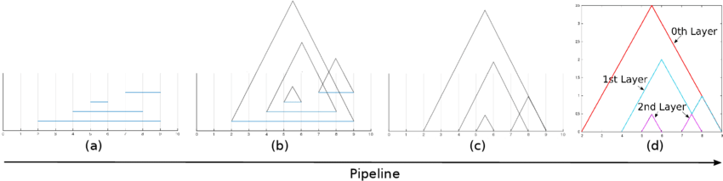
How does TDA work?
Barcode → persistence landscape
Why persistence landscape (instead of Barcode for ML)?

Slide 24
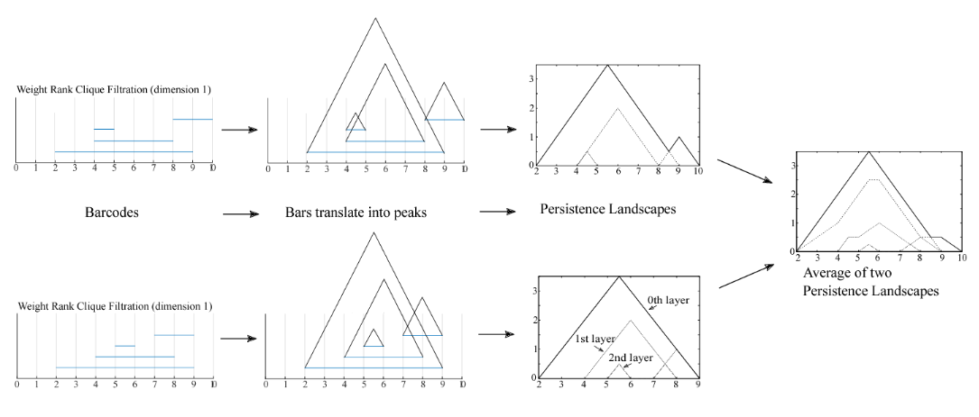
How does TDA work?
We can do statistics on it!

Slide 25
How does TDA work?
It’s in a matrix form
→ Machine loves matrices!

Slide 26
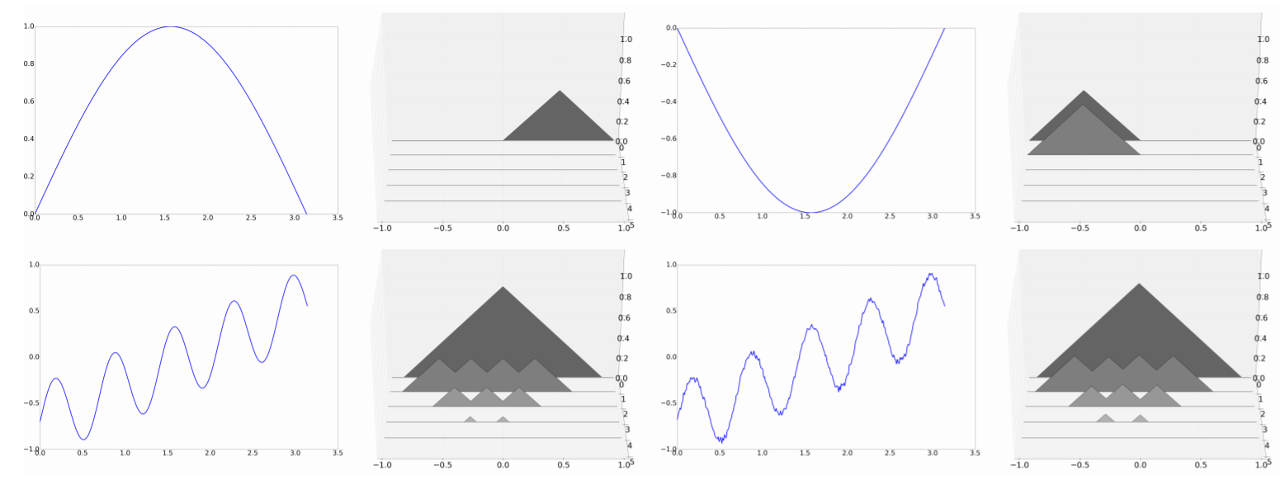
How does TDA work?
3. It’s persistent and robust over noises

Slide 27
How does TDA work?
What have we seen?
“Data has shape, shape matters”
TDA/Persistence Landscape is able to encode the shape of the data
Potentially novel features for supervised learning

Slide 28
The Model
“Online” Learning:
Roll 2w of data
Return/Change Features
Return/Change Features
Spread Features
Spread Features
XGBoost Model
(Training)
XGBoost Model
(Testing)
Y:
Ground Truth
$Y$:
Prediction
Volatility Features
Volatility Features
TDA Features
TDA Features

Slide 29
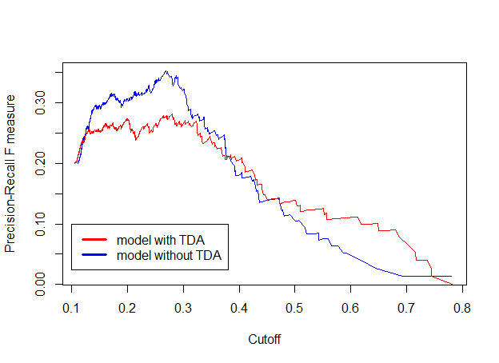
The Results 2.0 – HSI

Slide 30
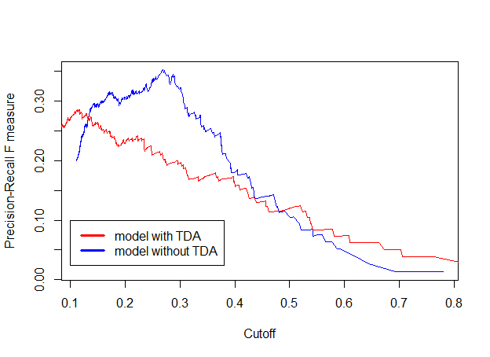

The Results 2.0 – S&P 500

Slide 31
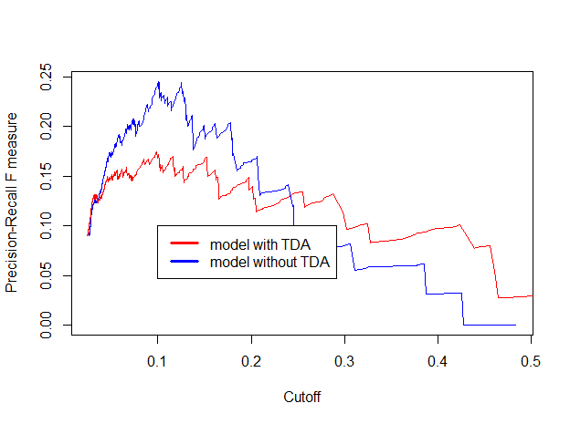
The Results 2.0 – FTSE 100

Slide 32
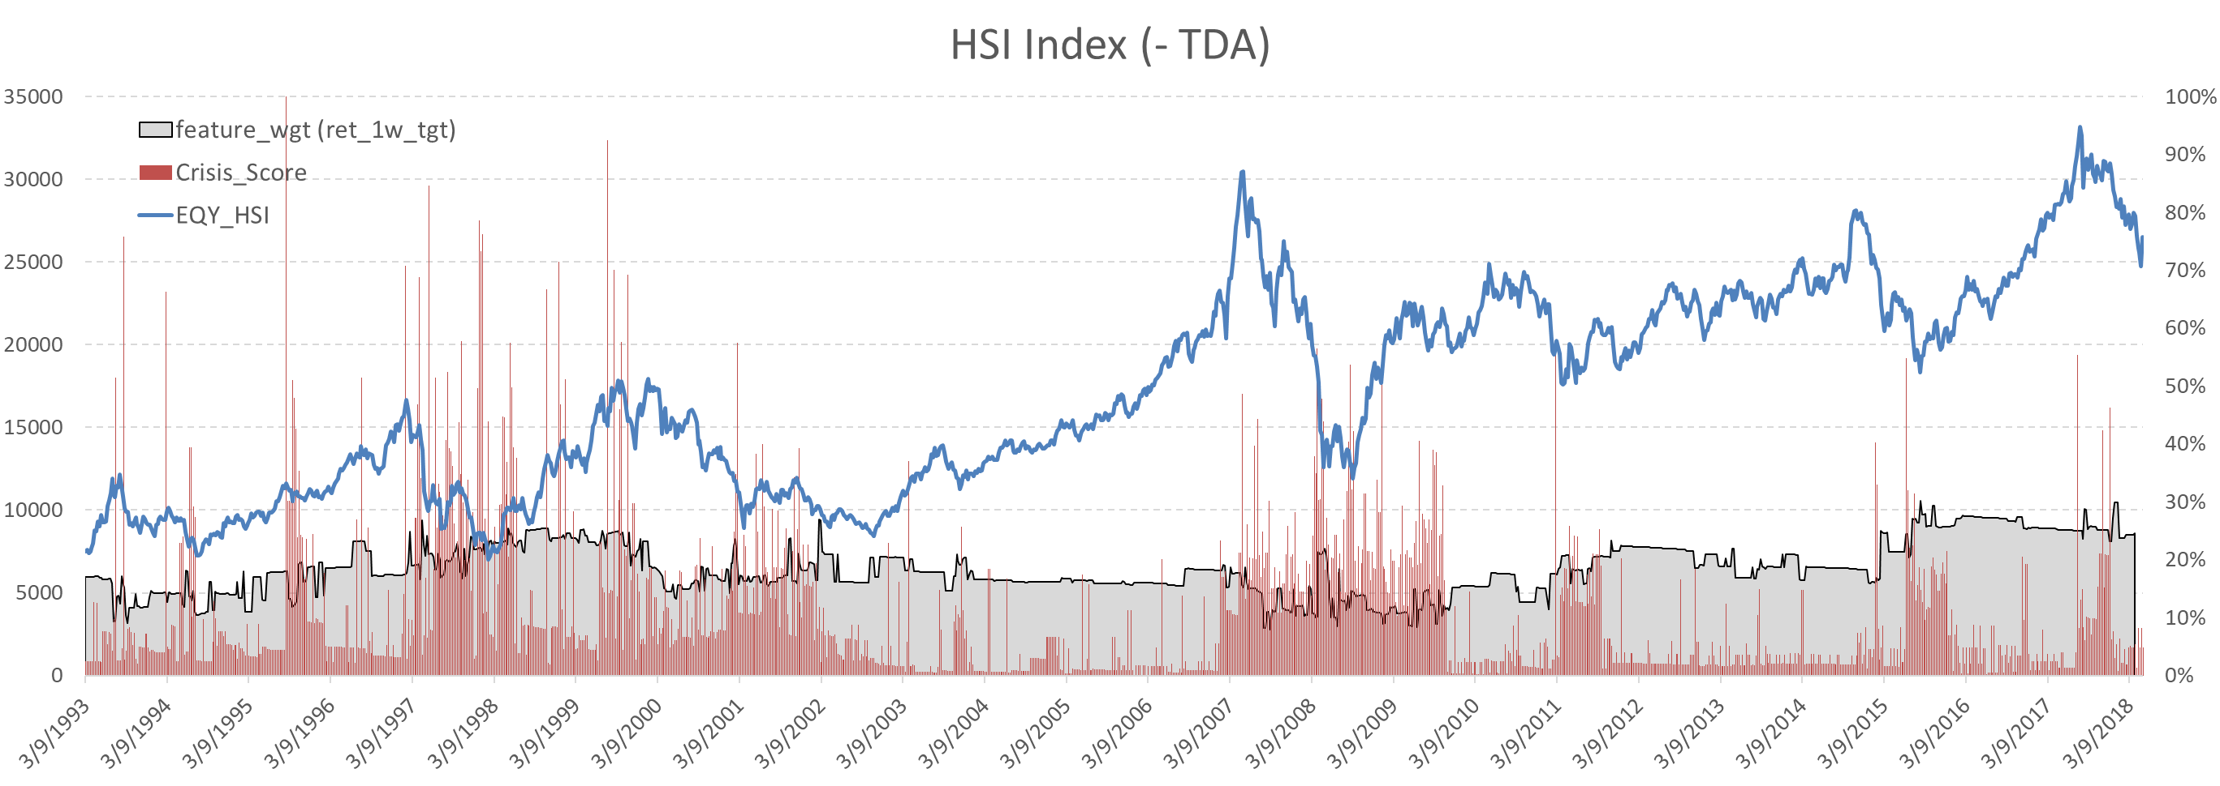
The Results in Details: HSI (-TDA)

Slide 33
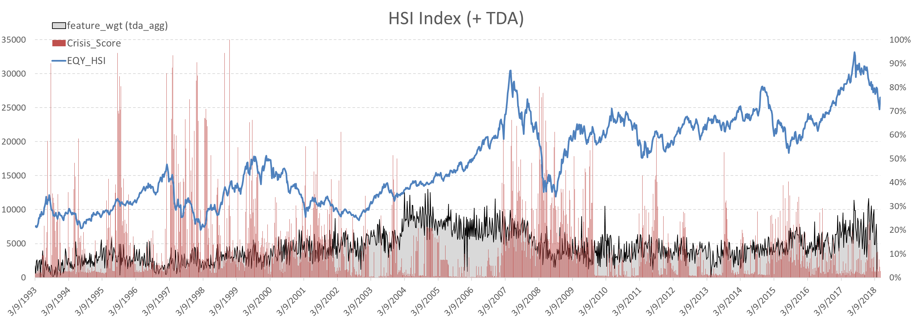
The Results in Details: HSI (+TDA)

Slide 34
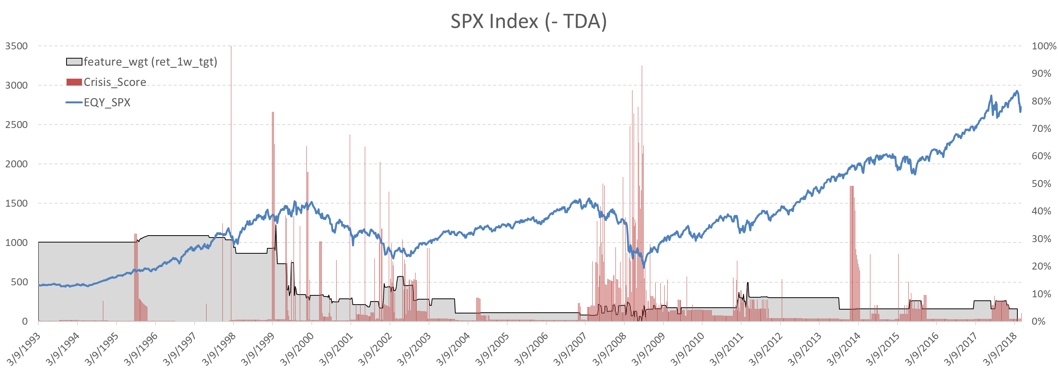
The Results in Details: S&P 500 (-TDA)

Slide 35
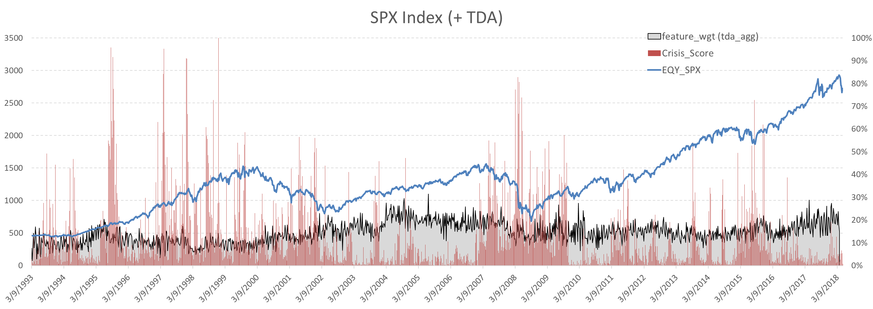
The Results in Details: S&P 500 (+TDA)

Slide 36
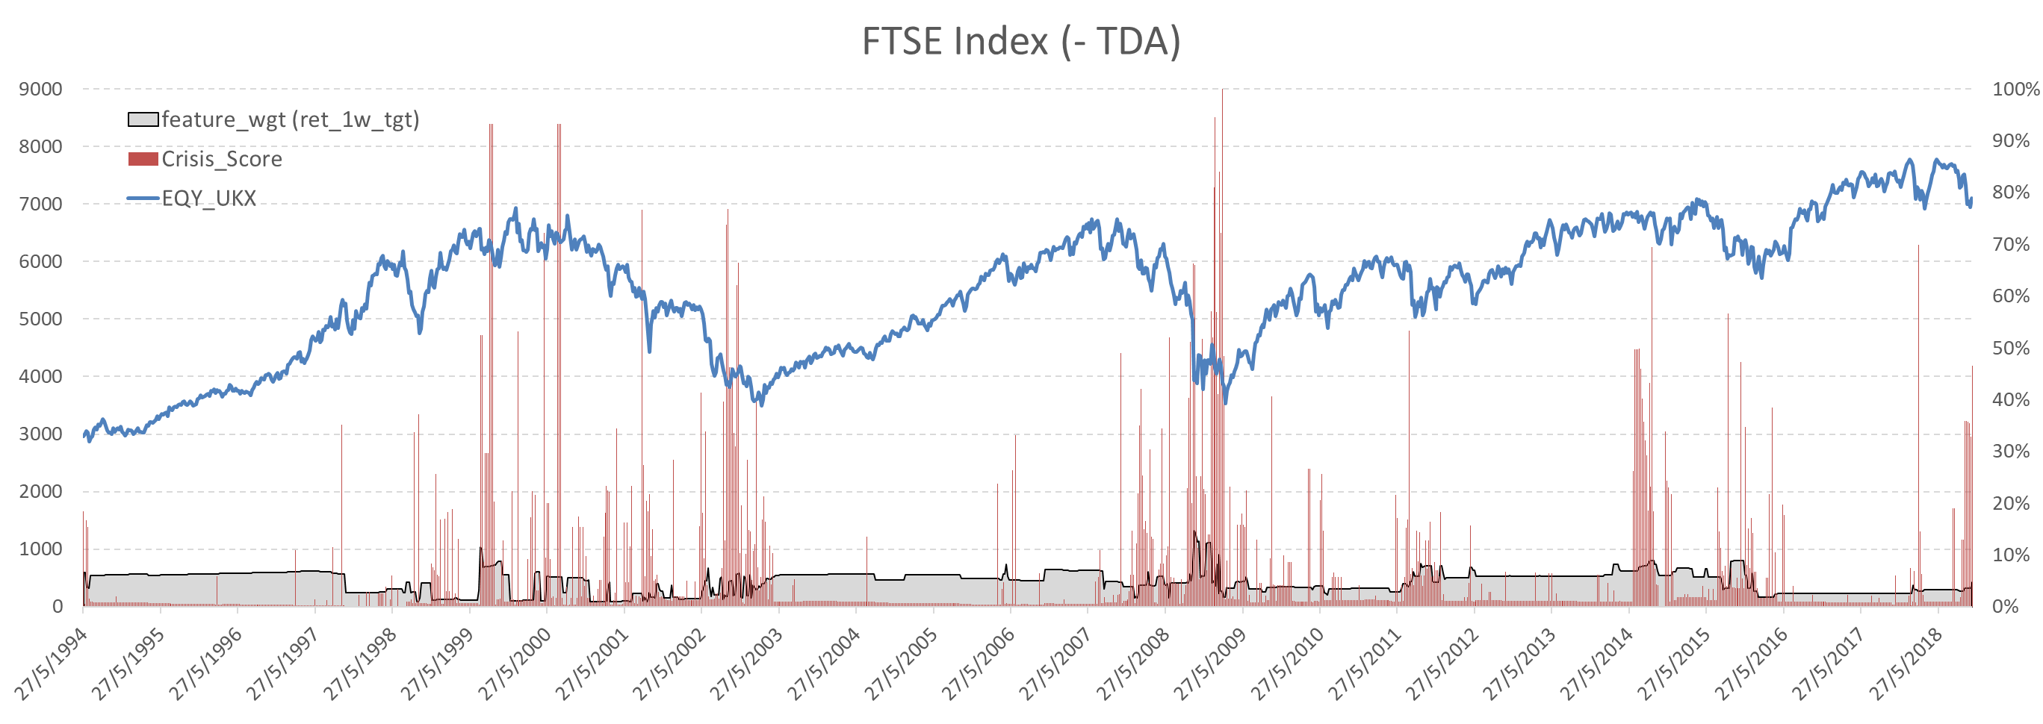
The Results in Details: FTSE 100 (-TDA)

Slide 37
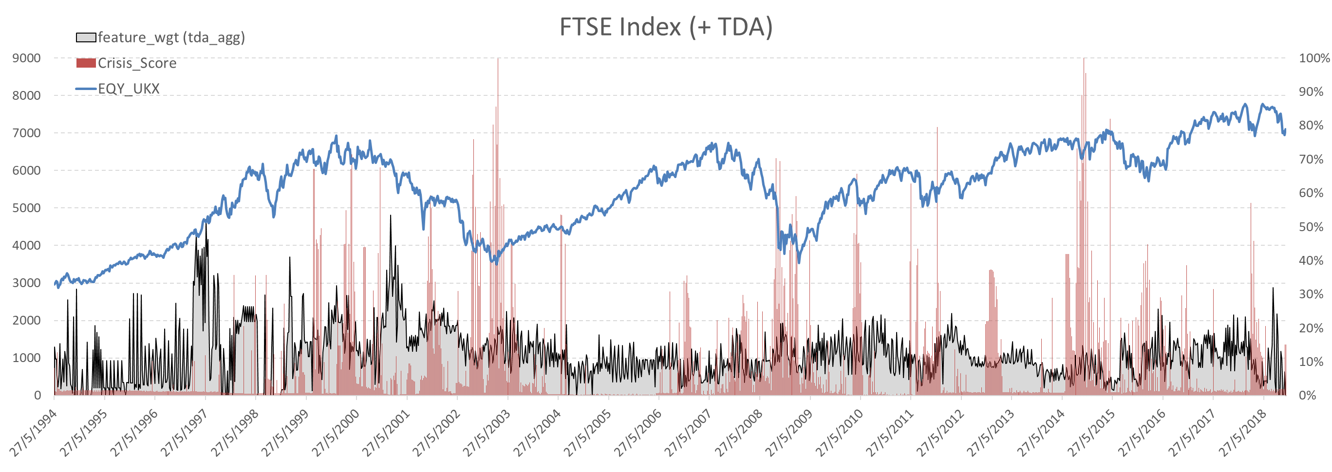
The Results in Details: FTSE 100 (+TDA)

